Slide 1
7th Semester Project (CS-721)
Heart Disease Prediction
Musale Krushna Pavan (CSE/16159/0000150)
Sanath Singavarapu (CSE/16033/0000188)
Under the supervision of
Bhaskar Biswas

Slide 2
What is Heart Disease Prediction?
Predicting the presence of heart disease with some specific health conditions of a human using machine learning approach.
The system uses different medical parameters such as age, sex, blood pressure, cholesterol, and obesity for prediction.

Slide 3
Why Heart Disease Prediction?
Heart disease affects human life very badly.
Predicting its cause and occurrence is a major challenge nowadays.
WHO has anticipated that 12 million people die every year because of heart diseases.
It require various medical tests and time consuming and involves our physical presence.

Slide 4
How do we solve this ?
Machine Learning Approach:
Machine learning is the scientific study of algorithms and statistical models that computer systems use to perform a specific task without using explicit instructions, relying on patterns and inference instead.

Slide 5
Problem Statement :
Aim: The main task is to figure out whether a person with some specific characteristics can be effected by heart disease or not.
Input: Age ,Sex , Chest Pain, Blood Pressure and some other health conditions.
Constraints: Less resources for data.

Slide 6
Approach:
Appling different machine learning algorithms
Tuning with different parameters
Comparison between the different matrix and algorithms
Considering the one having the best results

Slide 7
Steps followed in ML Approach:
Set up training data.
Set up the testing data.
Set up model parameters.
Train the model.
Predict the test data.
Evaluation.

Slide 8
Algorithms and Models:
1. K Neighbors Classifier
2. Support Vector Machine
3. Decision Tree Classifier
4. Random Forest Classifier
5. Voting Classifier

Slide 9
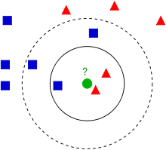
K Neighbors Classifier:
The accuracy that we get using this model: 87%
Ref :https://medium.com/@srishtisawla/k-nearest-neighbors-f77f6ee6b7f5

Slide 10
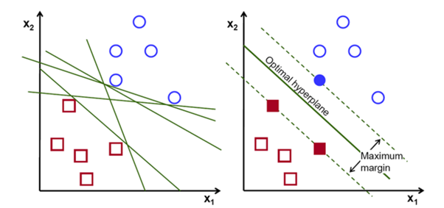
Support Vector Machine:
The accuracy that we get using this model: 84%
Ref : https://medium.com/machine-learning-101/chapter-2-svm-support-vector-machine-theory-f0812effc72

Slide 11
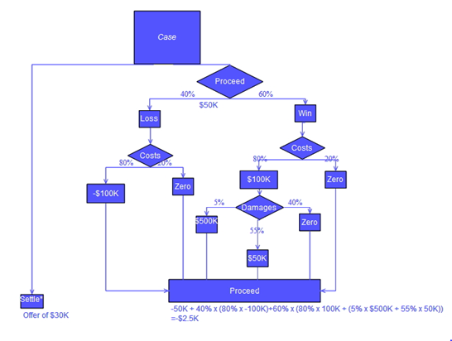
Decision Tree Classifier:
The accuracy that we get using this model: 84%

Slide 12
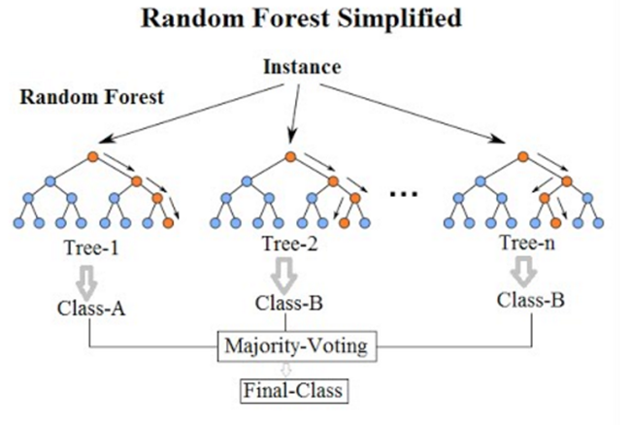
Random Forest Classifier:
The accuracy that we get using this model: 84%

Slide 13
Ensemble Algorithms:
The fundamental principle of the ensemble model is that a group of weak learners come together to form a strong learner, which increases the accuracy of the model.

Slide 14
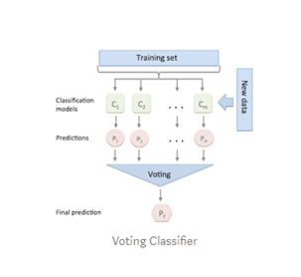
Voting Classifier:
The accuracy that we get using this model: 87%

Slide 15
Methodology:
About the Dataset:
Cleveland Heart Disease dataset taken from the UCI repository.
Parameters: Age , Sex , Chest-Pain , Resting-Blood Pressure , Serum Cholesterol , Fasting Blood Sugar, Resting ECG, Max Heart Rate Achieved , Exercise Induced Angina, ST Depression , Peak Exercise ST segment , No of major vessels colored by fluoroscopy, Thal

Slide 16
Training a ML model:
Training an ML model involves providing an ML algorithm with training data to learn from.
The training data must contain the correct answer, which is known as a target or target attribute.
The learning algorithm finds patterns in the training data that map the input data attributes to the target and it outputs.

Slide 17
Results:
K Nearest neighbors:
Without cross validation
Support Vector Machine :
Without cross validation
K value | Accuracy
1 | 0.76
2 | 0.78
4 | 0.84
6 | 0.86
8 | 0.87
10 | 0.83
Kernal | Accuracy
Linear | 0.83
Poly | 0.68
Rpf | 0.82
Sigmoid | 0.79
With Cross Validation for the best of k=8: 79.828%
With cross validation for best of kernel = linear: 80.450%

Slide 18
Results:
Decision Tree:
Without Cross validation
Random forest:
With cross validation
Max Features | Accuracy
1 | 0.75
4 | 0.71
7 | 0.81
11 | 0.76
14 | 0.68
Estimators | Accuracy
10 | 0.79
50 | 0.81
100 | 0.84
300 | 0.83
With cross Validation for the best resulted max features: 69.8%
With cross Validation for the best resulted max: 78.156%

Slide 19
Results:
Voting Classifier:
Without Cross validation: 87%
With cross Validation : 80.485%

Slide 20
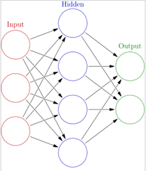
Future Scope:
Artificial Neural Networks:
Neural networks are a set of algorithms, modelled loosely after the human brain, that are designed to recognize patterns.
When gathered an enough data for training of neural network . The model will better learn the pattern of the data.

Slide 21
Conclusion:
Out of all the algorithms that we have used to train and predict , Voting Classifier gave us the best results of all .
This Heart Disease Prediction Model can now be used for predicting any new data entry.

Slide 22
Thank You

